Slide 1

Business Data Management Project - Analysis of Revenue Trend and Sales Volume of a Local Multipurpose Store
Soham Bhattacharya
Indian Institute of Technology, Madras
21f3001729@ds.study.iitm.ac.in
August 28, 2023
Soham Bhattacharya (IITM)
BDM Capstone Project
August 28, 2023
1/10

Slide 2
Overview
Data Collection
Clean Dataset
SKU Dictionary
General Analysis on Sales Data/Revenue Data
Sales Pareto and Revenue Pareto
Daily Sales and Daily Revenue
Revenue generated per Business Unit
Sales Trend
Sales trend pattern for important categories
Observations based on the trend patterns
Soham Bhattacharya (IITM)
BDM Capstone Project
August 28, 2023
2/10

Slide 3
Data Collection
Data Collected
Date Drinking Water bottles Soda Bourbon ...
Category Beverages Beverages Biscuits ...
08-01-2022 18 18 14 ...
08-02-2022 21 22 15 ...
...
Table: The data supplied has 29 columns, one for Date and remaining for different product items whose categories were mentioned in the row beneath. Data Pre-processing and cleaning and EDA on this cleaned data was performed using Microsoft Excel.
Soham Bhattacharya (IITM)
BDM Capstone Project
August 28, 2023
3/10

Slide 4
Clean Dataset
Cleansed Dataset
Date Day Month Category SKU Item-Name Price Sales Revenue
08-01-2022 Mon Aug-22 Beverages BE01 Drinking Water Bottle Rs.20 18 Rs.360
08-01-2022 Mon Aug-22 Beverages BE02 Drinking Soda Rs.15 18 Rs.270
08-01-2022 Mon Aug-22 Biscuits BI01 Bourbon Rs.25 14 Rs.350
...
Table: The data supplied has 29 columns, one for Date and remaining for different product items whose categories were mentioned in the row beneath. Data Pre-processing and cleaning and EDA on this cleaned data was performed using Microsoft Excel.
Soham Bhattacharya (IITM)
BDM Capstone Project
August 28, 2023
4/10

Slide 5
SKU Dictionary
Item Name SKU
Drinking Water Bottle BE01
Drinking Soda BE02
Soft Drink (Glass Bottle) BE03
Soft Drink (1L plastic bottle) BE04
Soft (500 ml plastic bottle) BE05
Bourbon BI01
Marie Biscuits BI02
Biskfarm Biscuits BI03
Haldiram Bhujia SN01
Bapuji Cake SN02
Chips SN03
Pack of bread SN04
Body Lotion COSM01
Deodorants COSM02
Item Name SKU
Face Cream COSM03
Black Ink Pen WMP01
Blue Ink Pen WMP02
Blank Long Notebook WMNT01
Lined Long Notebook WMNT02
Lined Short Notebook WMNT03
Blank Short Notebook WMNT04
Cover File WMF01
Envelope File WMF02
Large Envelope File WMF03
Lead Pencils (Set of 3) WMPE01
Graphite Pencils (Set of 6) WMPE02
Color Pencils Set WMPE03
Apsara Eraser Set WME01
Table: SKU Dictionary
Table: SKU Dictionary
Soham Bhattacharya (IITM)
BDM Capstone Project
August 28, 2023
5/10

Slide 6
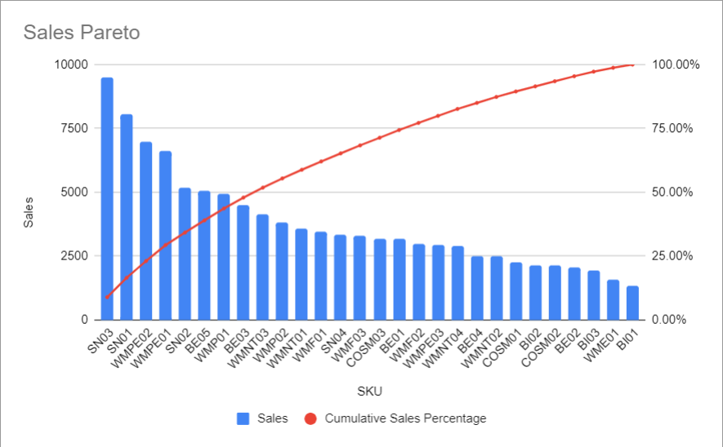
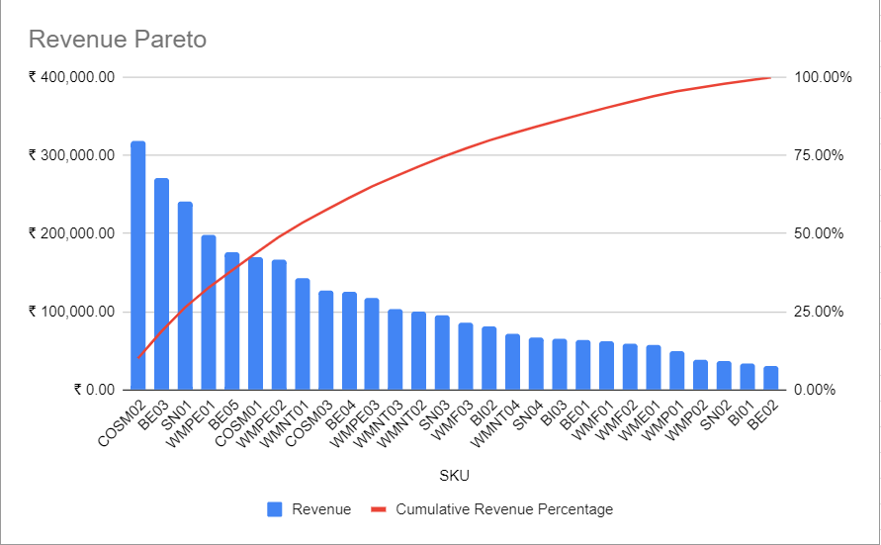
General Analysis on Sales Data/Revenue Data
Sales Pareto and Revenue Pareto
Figure: The Sales Pareto diagram
Figure: The revenue Pareto diagram
The pareto principle is not obeyed for both the figures
Soham Bhattacharya (IITM)
BDM Capstone Project
August 28, 2023
6/10

Slide 7
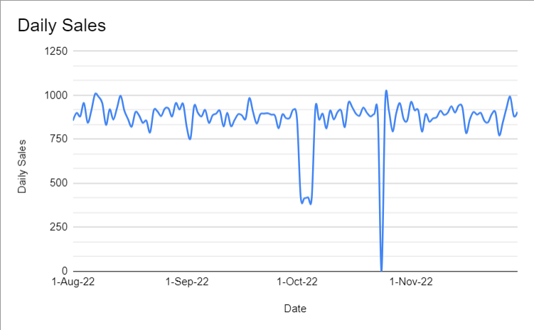
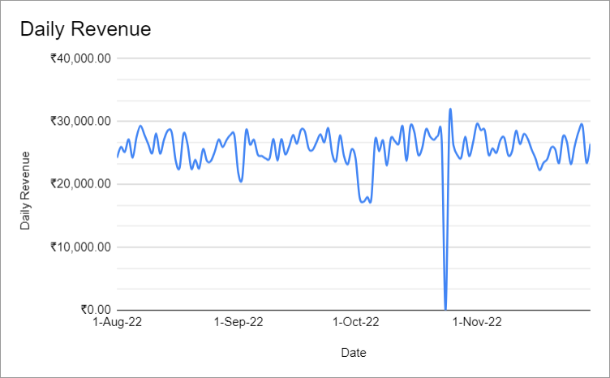
General Analysis on Sales Data/Revenue Data
Daily Sales and revenue trend
The trend in daily sales and daily revenue proves to be significantly stable over the period of four months.
Exceptions
We see a significant drop in the sales figure during the period 1st Oct 2022 to 5th Oct 2022. This is possibly due to the festival Durga-Puja, when the store remains open only for the first half of the day.
We see a reduction in the sales figure on 24th October 2022. Sales is zero on 24th October 2022 because the store was closed for the occasion of Kali-Puja.
Soham Bhattacharya (IITM)
BDM Capstone Project
August 28, 2023
7/10

Slide 8
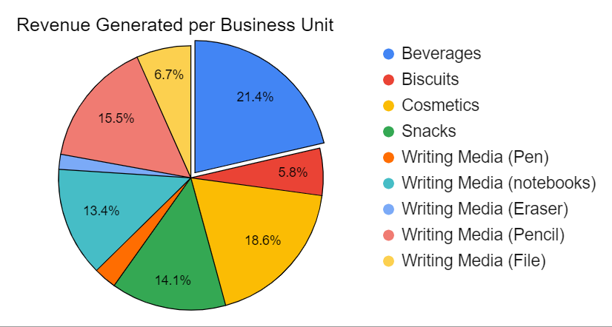

Revenue generated per business unit
Figure: Proportion of revenue generated per business unit
This is the revenue contribution of each category at this store.
We find that Beverages is the highest in terms of revenue generation at this store followed by Cosmetic, Pencil, Snack, Notebook, File, Biscuits, Pen and Eraser.
Eraser contributes the least in the net revenue of this store.
Soham Bhattacharya (IITM)
BDM Capstone Project
August 28, 2023
8/10

Slide 9
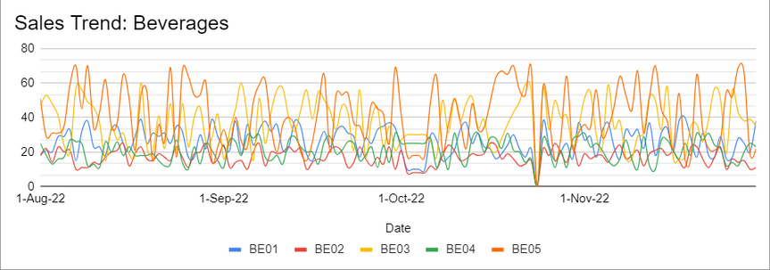
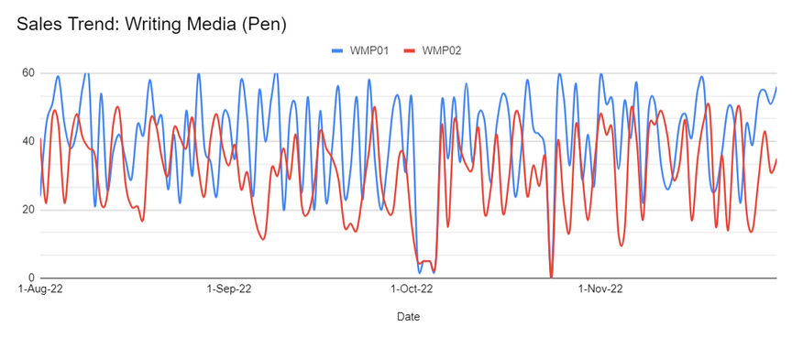
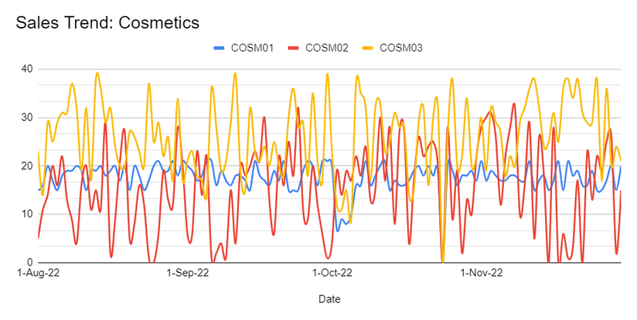
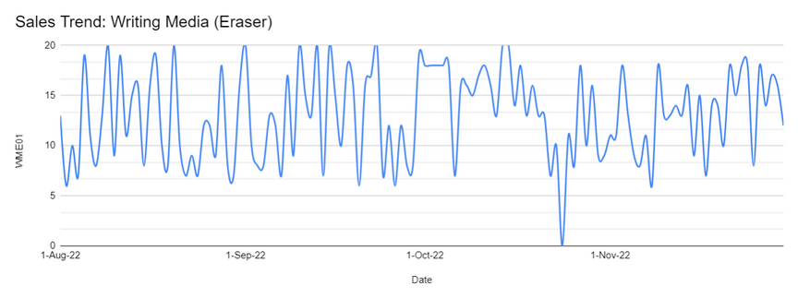
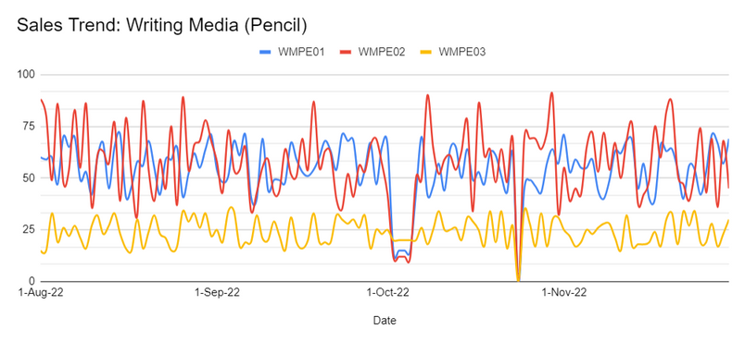
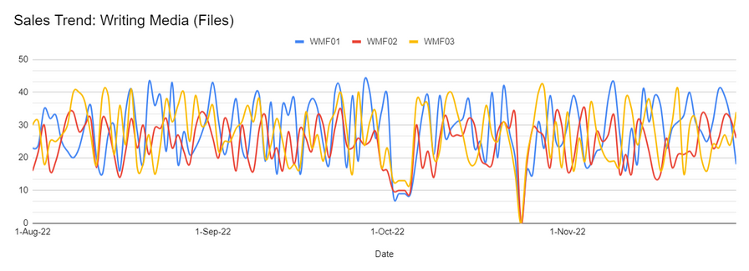
Sales Trend: Sales trend pattern for important categories
Soham Bhattacharya (IITM)
BDM Capstone Project
August 28, 2023
9/10

Slide 10
Sales Trend
Observations based on the trend patterns
BE05 is the most selling beverage at this store, followed by BE03, BE01, BE04, BE02 in that order. Since, BE02 remains quite low throughout, it is advisable to replace BE02 with a variant of BE05 or some other trending beverage in the market.
COSM03 is the most selling cosmetic product at this store followed by COSM01 and COSM02 in that order. Since we notice that the performance of COSM02 is very low throughout the period of four months, it is advisable to replace COSM02 with a variant of COSM03 or some other cosmetic product potentially capable of high sales in the current market.
WMPE02 is the most selling pencil at this store followed by WMPE01 and WMPE03. We notice that WMPE03 is significantly low during the entire period of four months. Hence, it is advisable to replace WMPE03 with a variant of WMPE02 or some new product potentially capable of high sales in the current market.
WMP01 is the better selling pen at this store than WMP02. We found that pen contribute less in the net revenue and there is no distinctive drop in the sales pattern, and hence introduction of variety of pens is advisable.
There is only one product for Erasers. It has an oscillating trend pattern in its sales. Erasers contribute the least in the net revenue generation. We know pencils and erasers are complements; since pencils are one of the highest selling products at this store, it advisable to replace WME01 with a variety of erasers.
WMF01 is the highest selling file at this store. Since, there is no significant difference in sales with the other products WMF02 and WMF03. increasing the inventory space for this category maybe done to increase the net revenue generated.
Soham Bhattacharya (IITM)
BDM Capstone Project
August 28, 2023
10/10

